Slide 1
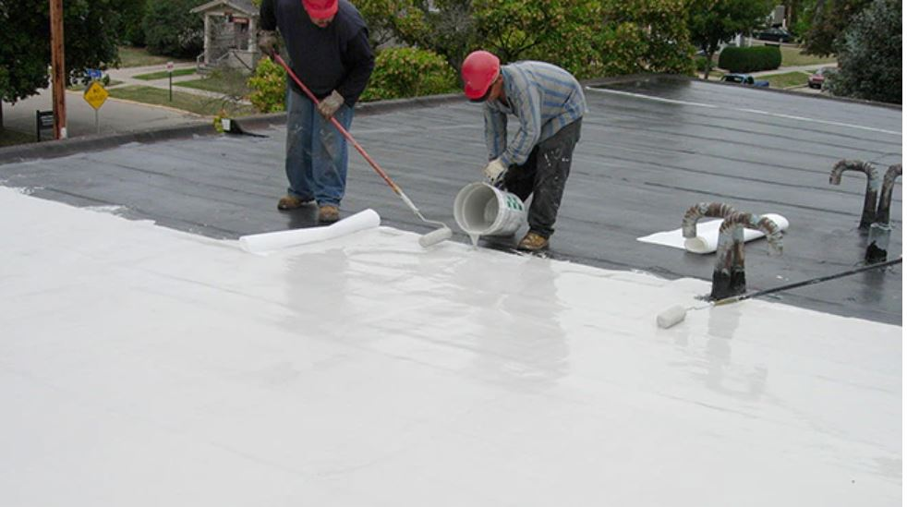
PMMA Sales 2020-2022
Sales of PMMA products by type, color and grade

Slide 2
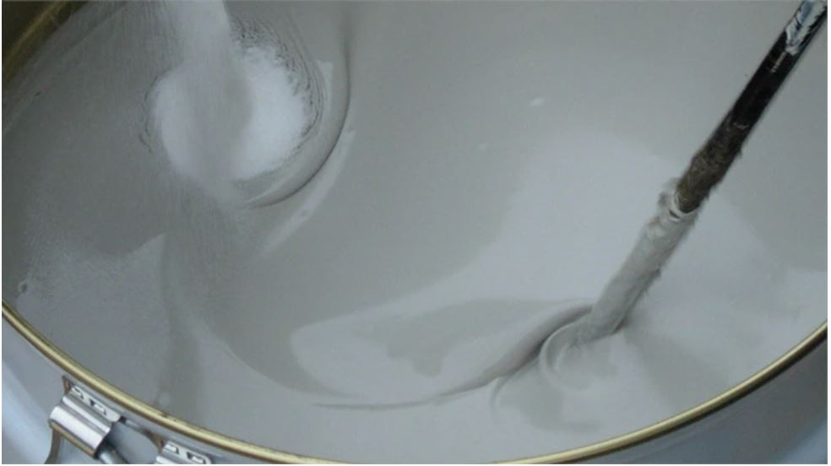
Introduction & Goal
My company sells 2 different types of PMMA liquid roofing products:
Roofing resin for flat surfaces,
Flashing resin for vertical surfaces.
Both products come in two colors: gray and white. Additionally, there are two grades available: winter and summer. That makes a total of 8 variations of this product.
The goal of this analysis is to find out which variant sold the most from 2020 to 2022. This should help with predicting sells of each variant in the future.

Slide 3
Important info
Data source:
CSV file imported from company sales system
Methodology:
The data source file has been cleaned by removing the unnecessary columns with customers’ addresses and names. I changed the the type of columns to float64 where needed. I changed the name of products to protect company data.
I created four data sets for further detailed analysis of each product:
roofing resin white, roofing resin gray, flashing resin white, flashing resin white
I used the sum function to sum the column with quantities to get the final count of sold products

Slide 4
PMMA classification
PMMA resins
Roofing Resin
Flashing Resin
Gray
White
Gray
White
Winter Grade
Summer Grade
Winter Grade
Summer Grade
Winter Grade
Summer Grade
Winter Grade
Summer Grade

Slide 5
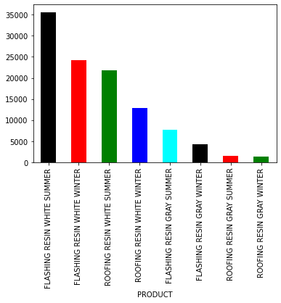
Sales quantity by product
SALES NUMBERS:
FLASHING RESIN GRAY SUMMER 7756
FLASHING RESIN GRAY WINTER 4342
FLASHING RESIN WHITE SUMMER 35584
FLASHING RESIN WHITE WINTER 24196
ROOFING RESIN GRAY SUMMER 1576
ROOFING RESIN GRAY WINTER 1300
ROOFING RESIN WHITE SUMMER 21844
ROOFING RESIN WHITE WINTER 12920
As predicted white color resins sell the most, especially for vertical surfaces.

Slide 6
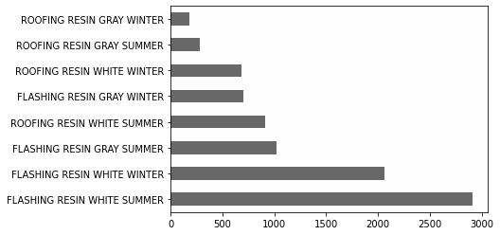
Sales orders by product
The sales order numbers follow the quantities of each variant sold with one exception.
Flashing Resin Gray Summer takes 3rd place in orders, while only 5th in qty sold.

